Slide 1
Tax Registrations 101
Presented by
Jeff Oberman
President
Realtax Inc.

Slide 2
You can make notes if you like...
…or you can download this presentation at
Realtax.ca
Resources
Tax Registrations 101

Slide 3
This presentation is only an overview
When conducting, or considering conducting, a tax registration, please refer to the pertinent legislation and regulations.

Slide 4
Definitions
Tax sale
The set of procedures that are required in order to offer a property for sale in order to recover realty tax arrears
Tax registration
The one-year long set of procedures that must be followed before you can commence tax sale procedures
Expedited tax sale
An expedited process that’s available if property was owned by a corporation that has been cancelled

Slide 5
Legislation and Rules
Legislation
  Main legislation is the Municipal Act, 2001, Part XI
    Some sections outside of Part XI are involved
    Other Acts that may also be involved, such as
      Farm Debt Mediation Act,
      Forfeited Corporate Property Act, 2015
  All section numbers in this presentation refer to the Municipal Act, 2001, unless otherwise noted
Rules
  Municipal Tax Sales Rules (“Rules”)
  O.Reg. 181/03 as amended by 571/17

Slide 6
Why do a tax registration?
All other collection efforts have failed
  This is the last resort
Highly effective
  On 85% of the properties we’ve handled the arrears were paid within 1 year—did not have to go to tax sale
No cost to municipality (usually)
  Costs are charged back to the properties that are in arrears (371(1))
  When the taxes are recovered, your costs are recovered

Slide 7
Why do a tax registration?
There is a cost to a municipality if
  A property is advertised for tax sale, but no one buys it
There’s still some cost recovery when this happens
  You must charge back to the school board and upper-tier (if applicable) a proportionate share of the amount that is being written off (353)

Slide 8
Getting Started
Second year of arrears
You can register a tax arrears certificate when a property is in at least it’s second year of arrears (373(1))
  Not two calendar years!
  If there are arrears from 2017 or earlier
    On 1 January 2018 property is in it’s first year of arrears
    On 1 January 2019 property is in it’s second year of arrears, so you can register any time after this day
Do you need to amend your collection policy?
If you were previously registering when a property was in at least it’s third year of arrears, you might need to amend your collection policy
Suggestion
Send a final warning letter—it’s not in the legislation, but it’s a good idea!

Slide 9
Notice under the Farm Debt Mediation Act
FDMA is federal legislation, gives farmers an opportunity to re-organize their debts before a creditor can take action to realize on a debt
Creditor must send a farmer a NOTICE OF INTENT TO REALIZE ON SECURITY at least 22 business days before taking action to realize on a debt (FDMA (21) and FDM Regulations 4(2)(c))
The way the Act is worded, it does not have to be a farm that is in tax arrears
If the property owner has an interest in a farming operation anywhere in Canada, you must send them a notice
Notice should be sent to assessed owner(s) before proceeding with tax registration
Link to the NOTICE
http://www.agr.gc.ca/eng/programs-and-services/farm-debt-mediation-service/notice-of-intent-by-secured-creditor/?id=1538136734881#genproc0

Slide 11
Title search and execution search
Need to find
  Legal description of property
  Name and address of Interested Parties (374(1)), because you have to send notices to them
  (well discuss Interested Parties shortly)
Conduct a corporate search if property is owned by a corporation

Slide 12
Can’t register a tax arrears certificate if…
    Order Cancelling Encumbrances has been registered by Crown (373.2(1)(a))
  This only applies to forfeited corporate lands
  Order does not cancel property taxes owed by former corporate owner
  You can still register if you obtain consent from the Crown
Notice of Intent to Use for Crown Purposes has been registered
  This can apply to forfeited corporate lands (373.2(1)(b)), or to
  Land that belongs to the Crown as a result of the death of an individual who did not have any lawful heirs (373.2(1)(c))
  Province will not register this if a tax arrears certificate has already been registered

Slide 13
The registration
Prepare a tax arrears certificate and register it on title (373(1))
  Municipal Tax Sales Rules, Schedule 1
Tax arrears certificate can’t include more than 1 separately assessed property (373.1(3))
  For example, if you have a subdivision of 10 separately assessed properties that are all in arrears, you need 10 tax arrears certificates
You need to know who the interested parties were on the day the tax arrears certificate was registered

Slide 14
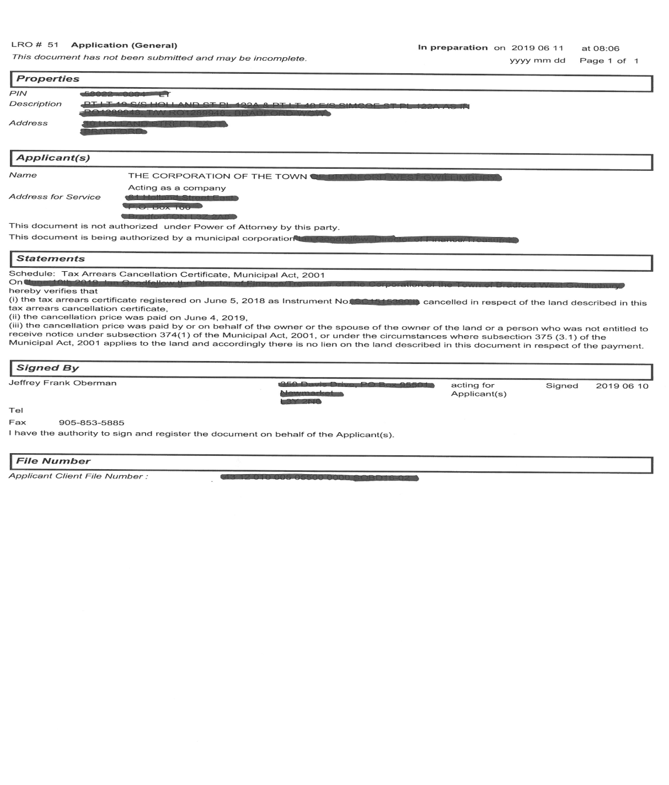

Slide 15
Who the Interested Parties are 374(1)
These are the parties you must send notices to
    Assessed owner(s)
    Spouse of assessed owner(s)
    Registered owner(s)
    Spouse of registered owner(s)
    Everyone else who had a registered interest on the day the tax arrears certificate was registered, except
      Parties whose interest is only through an easement or restrictive covenants
      (379 (7.1)(a))
      Crown in right of Canada or Ontario (379 (7.1)(b))
      There’s more…

Slide 16
More Interested Parties (374(1))
    If the Crown is shown as the assessed owner as a result of an escheat or forfeiture, you must also send notices to
  The Directors and Officers of the dissolved corporation
  Minister responsible for the administration of the Forfeited Corporate Property Act, 2015
    Where the treasurer is aware that the assessed owner is a dissolved corporation, must also send notices to
  Minister responsible for the administration of the Forfeited Corporate Property Act, 2015

Slide 17
Can you accept a partial payment?
If you have not yet registered a tax arrears certificate
  Yes, you can accept a partial payment
If you have registered a tax arrears certificate
  No, you cannot accept a partial payment
  (347(3)) ”No part payment shall be accepted on account of taxes in respect of which a tax arrears certificate is registered under this Act except under an extension agreement entered into under section 378.”
  (We’ll discuss extension agreements shortly)

Slide 18
Form 1—Notice of Registration of Tax Arrears Certificate
(“First Notices”)
Within 60 days of registration, prepare and send First Notices to Interested Parties (374(1))
  By personal delivery or registered mail (381(1))

Slide 19
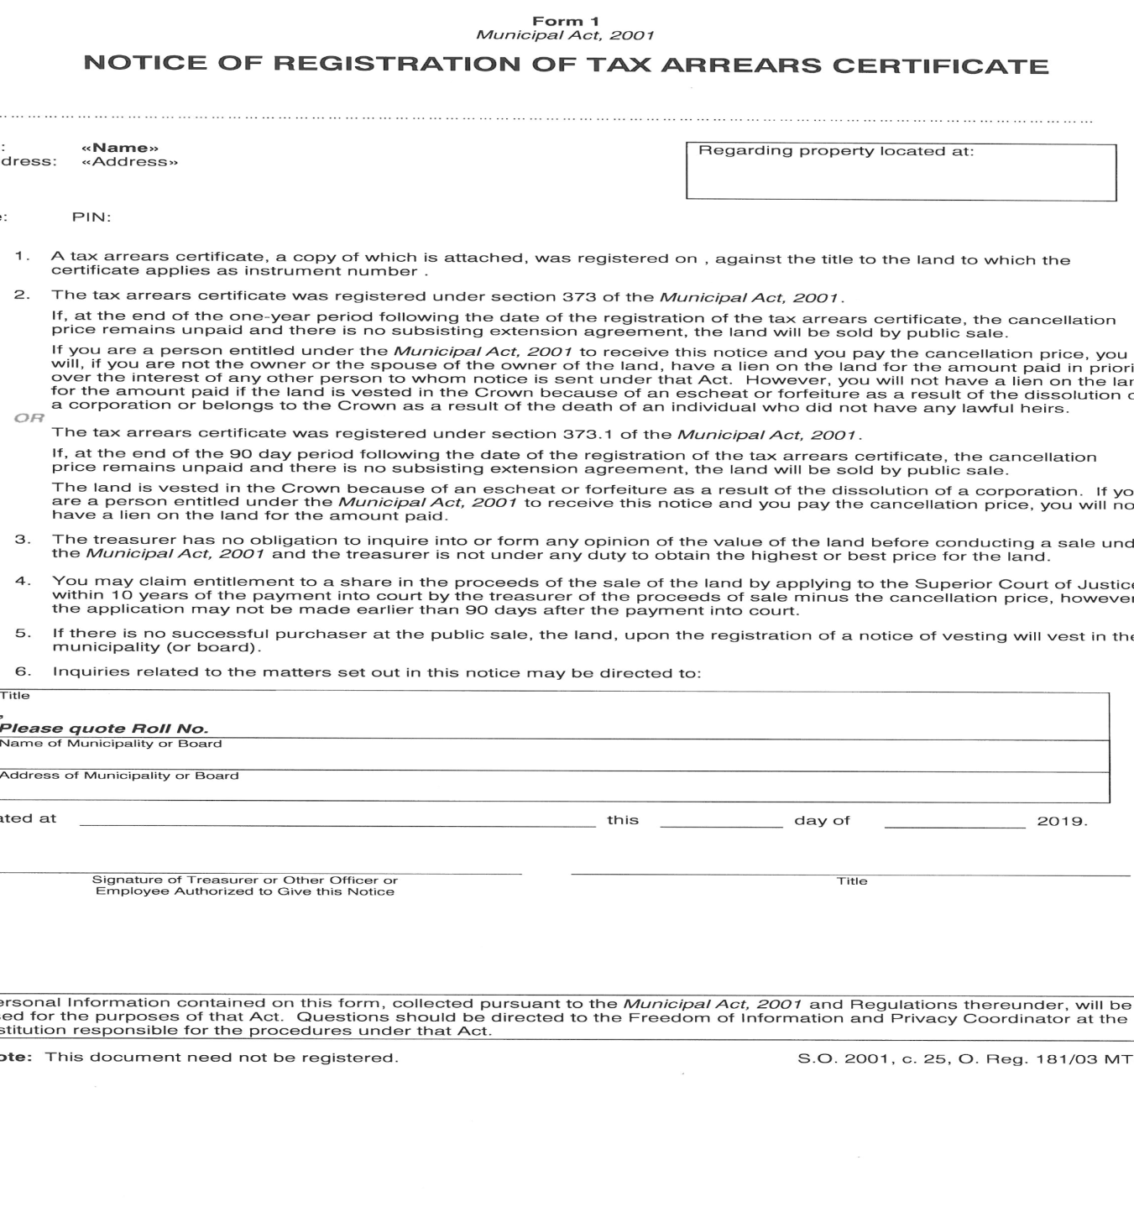

Slide 20
Form 2—Statutory Declaration Regarding Sending of Notice (374(3))
Sets out names, addresses, nature of interest, date notice was sent
Must be signed and commissioned
Does not have to be registered on title
If someone asks to inspect it, you must allow them to do so (374(4))

Slide 21
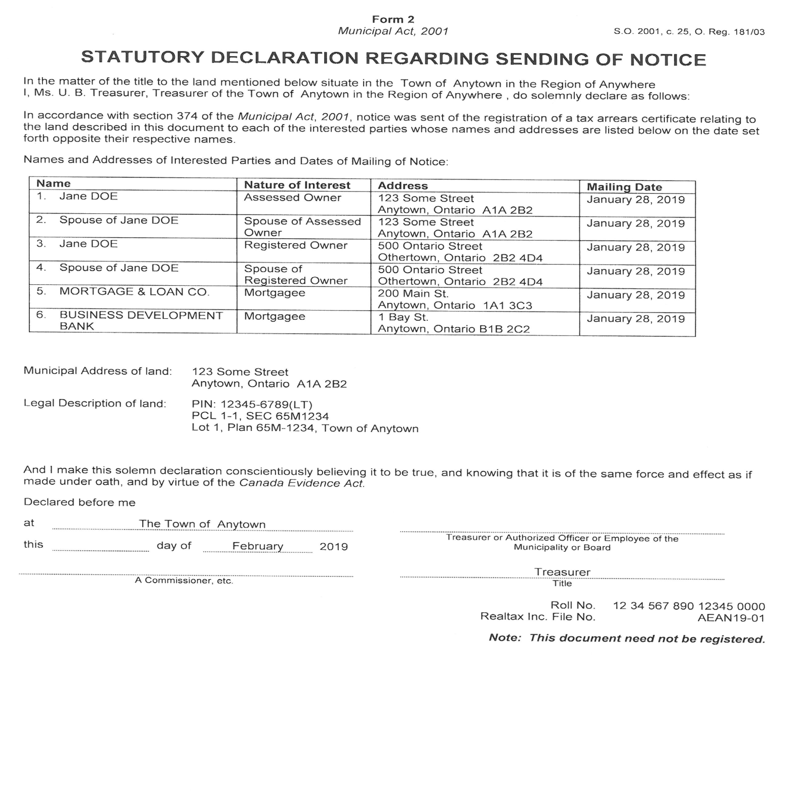

Slide 22
Form 3—Final Notice (379(1))
If the taxes have not yet been paid, must be sent 280 and 310 days after the registration of the tax arrears certificate
Must be sent to the parties who were entitled to receive First Notices
Update the searches before you prepare the Final Notices
  Need to know if any interested parties have a new address

Slide 23
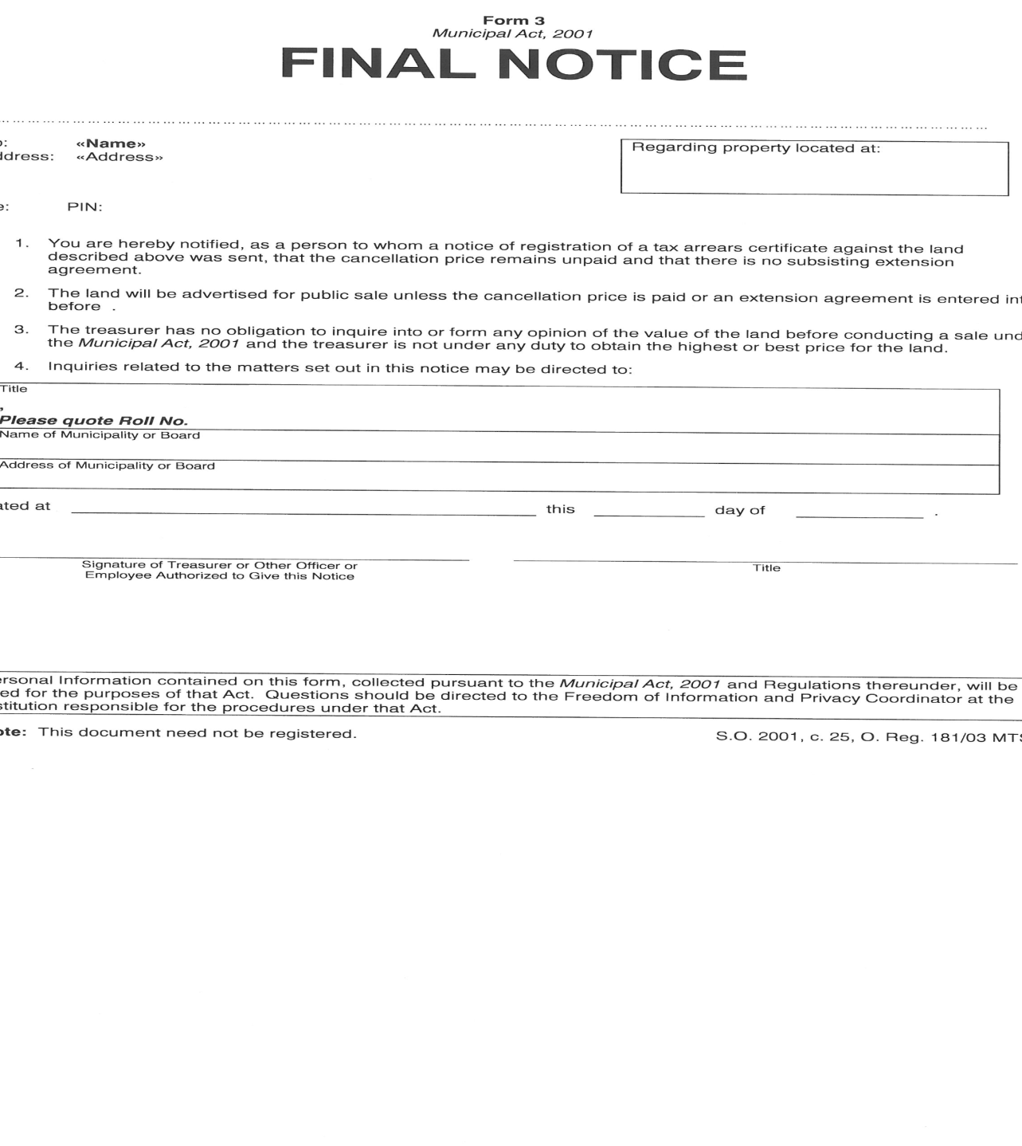

Slide 24
Extension Agreements (378(1))
Before the expiry of the one-year period
(that’s one year from the date of the registration of a tax arrears certificate)
a municipality may enter into an Extension Agreement with any of the following:
  Any owner of the land
  Spouse of any owner
  Any mortgagee
  Any tenant in occupation of the land
  Any person the treasurer is satisfied has an interest in the land

Slide 25
Extension Agreements (378(1))
Agreement cannot reduce the amount of the cancellation price, or prohibit any person from paying the cancellation price (378(2))
Extension Agreement “freezes the clock” that’s ticking down in the one-year period (378(4))
Agreement must state under what conditions it ceases to be considered a subsisting agreement (378(3)(a))
For example:
If any of the terms of the Agreement are not met, it ceases to be considered a subsisting agreement on the day that the treasurer notifies the party by registered mail.
When it ceases to be considered a subsisting agreement, the clock starts ticking again (378(4))
You may enter into an extension agreement, you do not have to!

Slide 26
Extension Agreements Authorized by Treasurer
Only pertains to properties where Tax Arrears Certificate was registered after January 1 2018 (388(2))
‘Municipality’ may enter into extension agreement; authorizing by-law is no longer required each time (378(1))
Municipality (Council) may delegate this authority to Treasurer or other Officer and set limits, or may decide to maintain status quo
Party to extension agreement can be anyone the treasurer is satisfied has an interest in the property (378(1)(1.1))
If extension agreement is in regards to cancelled corporate property, consent of the Minister of Infrastructure is required (378(1.2)

Slide 27
Schedule 2—Cancellation Certificate (375(1))
Legislation states,
“Before the expiry of the one-year period…any person may have a tax arrears certificate …cancelled by paying to the municipality the cancellation price as of the date the payment is tendered” (375(1)), (1.1)
But what if the one year-period has already expired? Should you accept the payment?
The short answer is,
YES!!! ABSOLUTELY ACCEPT THE PAYMENT!!!!

Slide 28
Expedited Tax Sales
These are properties owned by corporations that were cancelled or dissolved
Can register Tax Arrears Certificate (TAC) on title as soon as there are arrears (373.1)
First notices to be sent within 30 days of registration (374(1))
No final notices
Extension agreement can only be done within 90 days of registration (378(1.1))
Begin tax sale 90 days after registration of TAC (379(2.0.1))
No priority lien awarded if cancellation price paid (375(3.1))

Slide 29
Transferring certain properties to municipality without doing a tax sale
Order to Transfer
Province may transfer ‘certain’ properties directly to municipality (without tax sale) if appropriate (Forfeited Corporate Properties Act, 29)
  Includes properties such as 1foot reserves, storm water retention ponds, blocks for walkways and parks that were to be granted to the municipality as part of the Subdivision/Development Agreement but the corporation was cancelled before this was completed.

Slide 30
New Forms & Schedules
Forms 1 to 10
  (First and Final Notices, Statutory Declarations re: sending of Notices, Statement of Facts, Advertisements, Tender Form, etc.)
  are no longer found attached to the MTSR regulation but are available on line on the Government of Ontario Central Forms Repository under the listing for the Ministry of Municipal Affairs:
http://www.forms.ssb.gov.on.ca/mbs/ssb/forms/ssbforms.nsf/
Index of Forms and their official names for searching the Repository can be found in the MTSR Schedule 5
Updated Schedules 1 to 4 for the Tax Arrears and Cancellation Certificates and Statements to include with Tax Deeds and Vestings are
attached to the MTSR

Slide 31
KEY TAKE AWAYS
Make sure you notify all the required parties, within the required timeframes
Don’t accept a partial payment when you cannot
Do accept payment in full when you can

Slide 32
Thanks for coming to this workshop!
Jeff Oberman
President
Realtax Inc.
1-888-585-7555 Ext. 1
JeffOberman@Realtax.ca

